Slide 1
Introduction to Servlet

Slide 2
Objective
To learn
  Motivation
  Installation of Apache Tomcat Server
  Development & Deployment of Web application
Jackson, Web Technologies: A Computer Science Perspective, © 2007 Prentice-Hall, Inc. All rights reserved. 0-13-185603-0

Slide 3
Outcome
Students will be able to
  Install Apache Tomcat server
  Development & Deployment of web application
Jackson, Web Technologies: A Computer Science Perspective, © 2007 Prentice-Hall, Inc. All rights reserved. 0-13-185603-0

Slide 4
Context
HTML and CSS were helpful in designing non-interactive website
However, Javascript is useful to create interactive website
DOM is used to interact with HTML document
Servlet is the java program or module resides in the server to process the request
Jackson, Web Technologies: A Computer Science Perspective, © 2007 Prentice-Hall, Inc. All rights reserved. 0-13-185603-0

Slide 5
Server-side Programming
The combination of
  HTML
  JavaScript
  DOM
  is sometimes referred to as Dynamic HTML (DHTML)
Web pages that include scripting are often called dynamic pages (vs. static)
Jackson, Web Technologies: A Computer Science Perspective, © 2007 Prentice-Hall, Inc. All rights reserved. 0-13-185603-0

Slide 6
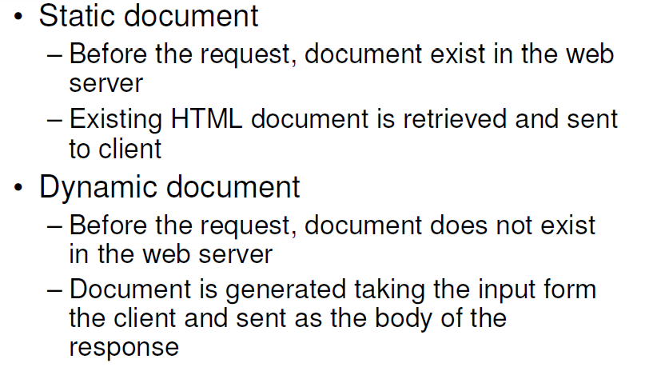
Server-side Programming
Jackson, Web Technologies: A Computer Science Perspective, © 2007 Prentice-Hall, Inc. All rights reserved. 0-13-185603-0

Slide 7
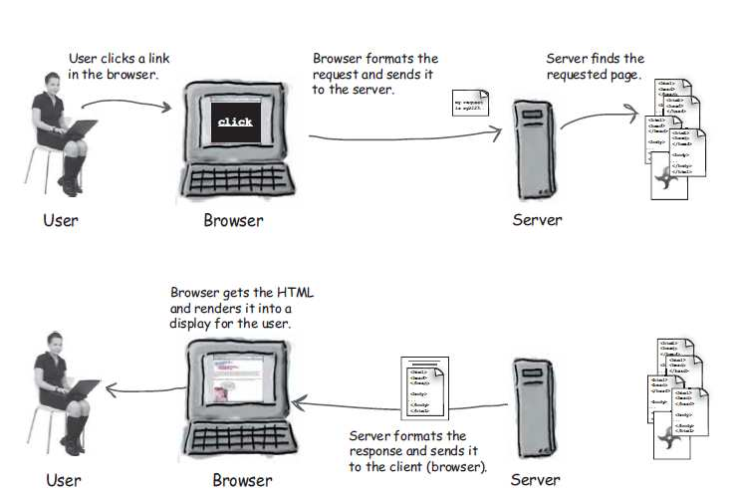
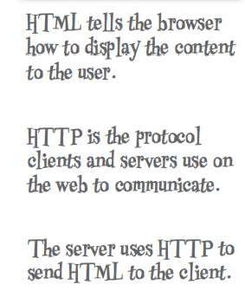
Static and Dynamic Document
Jackson, Web Technologies: A Computer Science Perspective, © 2007 Prentice-Hall, Inc. All rights reserved. 0-13-185603-0

Slide 8
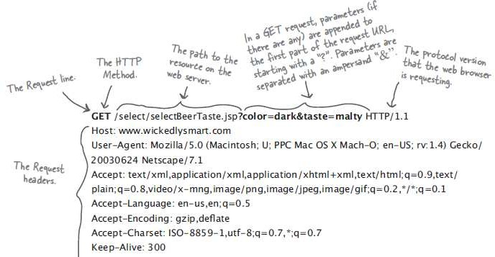
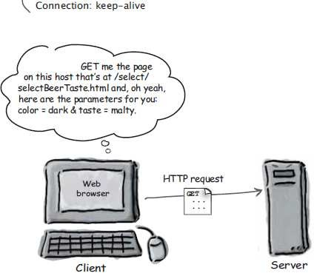
HTTP Request
K. Vallidevi
5

Slide 9
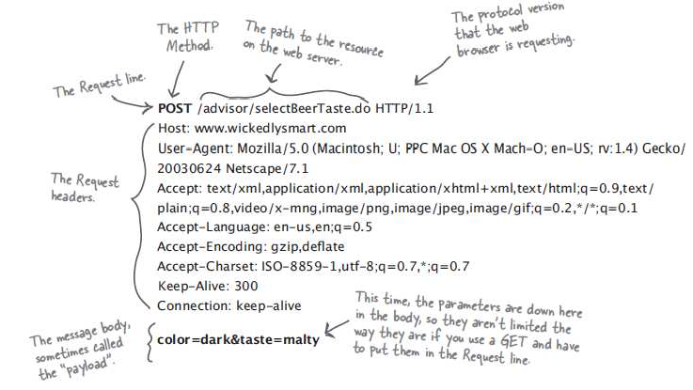
HTTP Response
K. Vallidevi

Slide 10
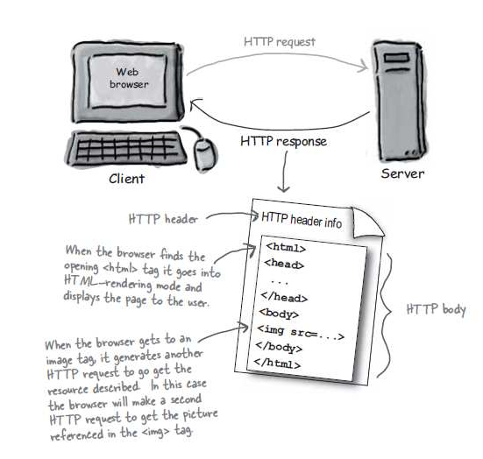
HTTP Response has HTML in it
K. Vallidevi

Slide 11
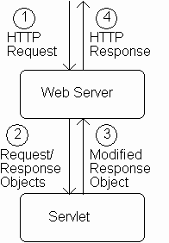
Servlet Overview
Jackson, Web Technologies: A Computer Science Perspective, © 2007 Prentice-Hall, Inc. All rights reserved. 0-13-185603-0

Slide 12
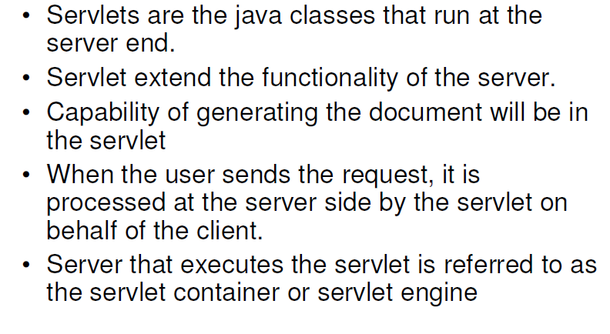
What are Servlet objects?
Jackson, Web Technologies: A Computer Science Perspective, © 2007 Prentice-Hall, Inc. All rights reserved. 0-13-185603-0

Slide 13
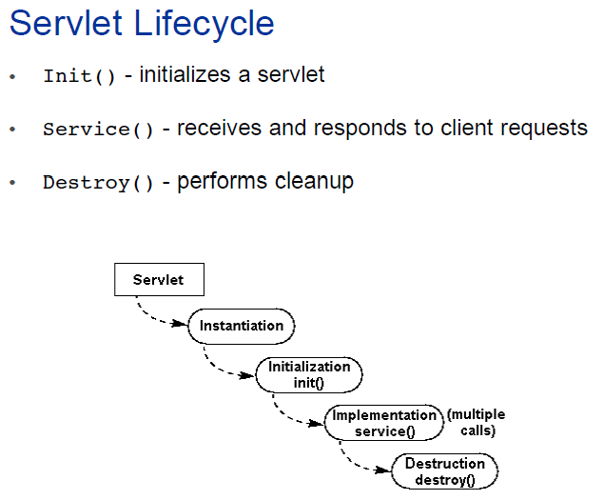
K. Vallidevi

Slide 14
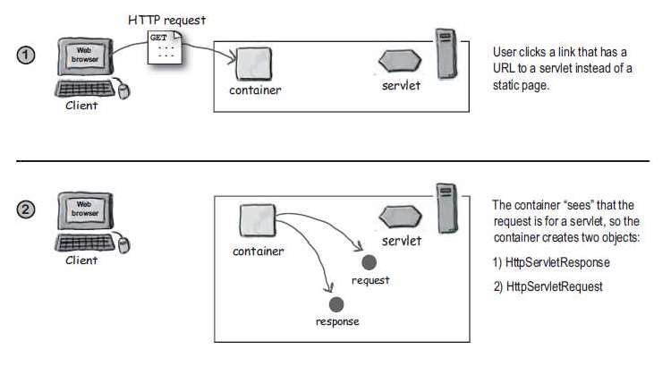
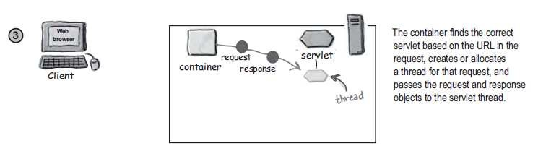
K. Vallidevi

Slide 15
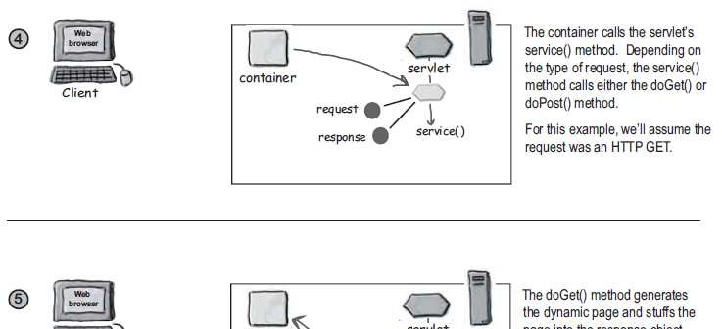
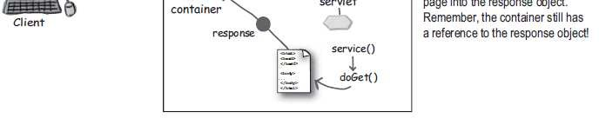
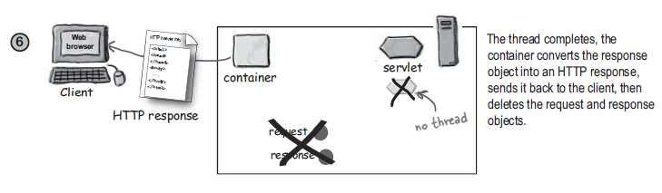
K. Vallidevi

Slide 16
Servlet Overview
When server starts it instantiates servlets
Server receives HTTP request, determines need for dynamic response
Server selects the appropriate servlet to generate the response, creates request/response objects, and passes them to a method on the servlet instance
Servlet adds information to response object via method calls
Server generates HTTP response based on information stored in response object
Jackson, Web Technologies: A Computer Science Perspective, © 2007 Prentice-Hall, Inc. All rights reserved. 0-13-185603-0

Slide 17
Installation of Tomcat Server
In Google, Type Apache Tomcat Installation Ubuntu 16.04 and find the liquid website
Download tar file of Apache Tomcat 8.5.50 from Liquidweb site
Extract and place it in /usr/local
Check the version of java and its availability
Usually we find in /usr/lib/jvm
Need to set JAVA_HOME, PATH & CATALINA_HOME in bashrc file
Jackson, Web Technologies: A Computer Science Perspective, © 2007 Prentice-Hall, Inc. All rights reserved. 0-13-185603-0

Slide 18
Installation of Tomcat Server
bashrc is a hidden file in home folder (~)
Open the bashrc file using nano editor
sudo nano ~/.bashrc
Add the following
  JAVA_HOME=“/usr/lib/jvm/java-1.8-openjdk-amd64”
  PATH=$PATH:$JAVA_HOME
  CATALINA_HOME=“/usr/local/apache-tomcat=8.5.50
Update bashrc file using any one of the commands
  source ~/.bashrc
  . ~/.bashrc
Jackson, Web Technologies: A Computer Science Perspective, © 2007 Prentice-Hall, Inc. All rights reserved. 0-13-185603-0

Slide 19
Installation of Tomcat Server
Check the environment variables by the following commands
  $JAVA_HOME
  $PATH
  $CATALINA_HOME
Start the server
  $CATALINA_HOME/startup.sh
Type the following in browser to check the administration page of Tomcat
  http://localhost:8080
Jackson, Web Technologies: A Computer Science Perspective, © 2007 Prentice-Hall, Inc. All rights reserved. 0-13-185603-0

Slide 20
Installation of Tomcat Server
Take demo Servlet from the following link
  https://www.javatpoint.com/steps-to-create-a-servlet-using-tomcat-server
Extract the folder, you will get demo servlet
Place the demo servlet in webapps folder in apache-tomcat-8.5.50
Type the following in browser to check demo servlet
  http://localhost:8080/demo
Shutdown the server
  $CATALINA_HOME/bin/shutdown.sh
Jackson, Web Technologies: A Computer Science Perspective, © 2007 Prentice-Hall, Inc. All rights reserved. 0-13-185603-0

Slide 21
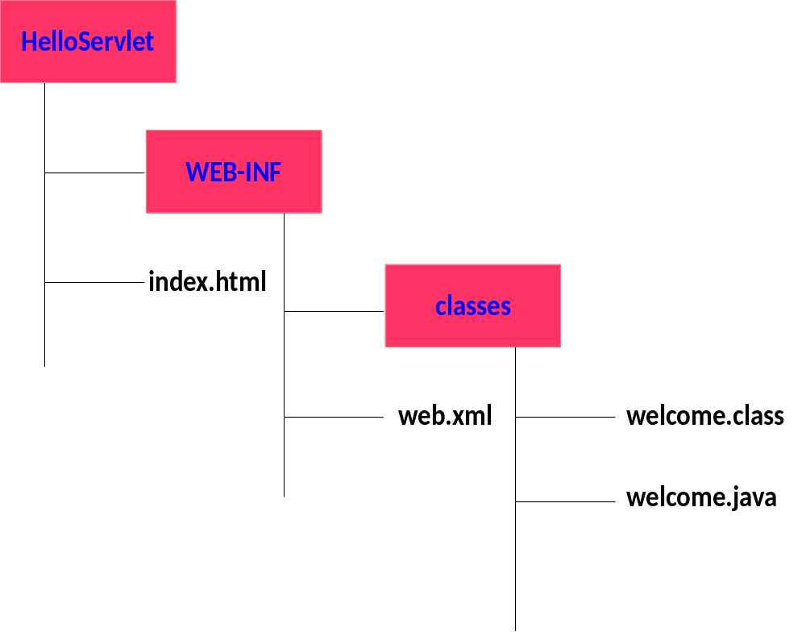
Development of our FirstServlet
Create the following hierarchy
Jackson, Web Technologies: A Computer Science Perspective, © 2007 Prentice-Hall, Inc. All rights reserved. 0-13-185603-0

Slide 22
Development of our FirstServlet
Index.html
<html>
<body>
<form method=“get” action=“hello”>
<input type=“submit”>
</form>
</body>
</html>
Jackson, Web Technologies: A Computer Science Perspective, © 2007 Prentice-Hall, Inc. All rights reserved. 0-13-185603-0

Slide 23
Development of our FirstServlet
Web.xml
<web-app>
<servlet>
<servlet-name>MyServlet1</servlet-name>
<servlet-class>First</servlet-class>
</servlet>
<servlet-mapping>
<servlet-name>MyServlet1</servlet-name>
<url-pattern>/hello</url-pattern>
</servlet-mapping>
</web-app>
Jackson, Web Technologies: A Computer Science Perspective, © 2007 Prentice-Hall, Inc. All rights reserved. 0-13-185603-0

Slide 24
Development of our FirstServlet
First.java
import javax.servlet.http.*;
import javax.servlet.*;
import java.io.*;
public class First extends HttpServlet{
public void doGet(HttpServletRequest req,HttpServletResponse res)throws ServletException,IOException
{
res.setContentType("text/html");
Jackson, Web Technologies: A Computer Science Perspective, © 2007 Prentice-Hall, Inc. All rights reserved. 0-13-185603-0

Slide 25
Development of our FirstServlet
First.java
PrintWriter pw=res.getWriter();
pw.println(“<html>”);
pw.println(“<body>”);
pw.println(“<p>Hello World</p>”);
pw.println(“</body>”);
pw.println(“</html>”);
pw.close();
}}
Jackson, Web Technologies: A Computer Science Perspective, © 2007 Prentice-Hall, Inc. All rights reserved. 0-13-185603-0

Slide 26
Development of our FirstServlet
Deployment of application
Place the folder FirstServlet in webapps folder
Copy the servlet-api.jar available in tomcat/lib folder to /usr/lib/jvm/java…/jre/lib/ext folder
Compile the First.java to get its class file
Start the server
Execute the servlet
http://localhost:8080/HelloServlet
Shutdown the server
Jackson, Web Technologies: A Computer Science Perspective, © 2007 Prentice-Hall, Inc. All rights reserved. 0-13-185603-0

Slide 27
Development of our FirstServlet
In case of myfirst.html instead of index.html
In deployment descriptor, add the following
<welcome-file-list>
<welcome-file>myfirst.html</welcome-file>
</welcome-file-list>
Try executing the web application
Jackson, Web Technologies: A Computer Science Perspective, © 2007 Prentice-Hall, Inc. All rights reserved. 0-13-185603-0

Slide 28
Development of our FirstServlet
Add style in First.java and to retrieve the value from form
In index.html
  <input type=“text” name=“t1”>
In First.java
  String str=resp.getParameter(“t1”);
  out.println(“<p>”+str+”</p>”);
Jackson, Web Technologies: A Computer Science Perspective, © 2007 Prentice-Hall, Inc. All rights reserved. 0-13-185603-0

Slide 29
Simple Questions
What environment variables have to be set during installation of Apache Tomcat Server?
How to set or update these environment variables in Ubuntu?
How to configure web application?
What is deployment descriptor?
How to retrieve data in servlet from the form?
Jackson, Web Technologies: A Computer Science Perspective, © 2007 Prentice-Hall, Inc. All rights reserved. 0-13-185603-0

Slide 30
References
Deitel and Deitel and Nieto, ―Internet and World Wide Web - How to Program‖, Prentice Hall, 5th Edition, 2011.
Jeffrey C and Jackson, ―Web Technologies A Computer Science Perspective‖, Pearson Education, 2011.
Jackson, Web Technologies: A Computer Science Perspective, © 2007 Prentice-Hall, Inc. All rights reserved. 0-13-185603-0

Slide 31
Summary
Students will be able to
  Install Apache Tomcat server
  Development & Deployment of web application
Jackson, Web Technologies: A Computer Science Perspective, © 2007 Prentice-Hall, Inc. All rights reserved. 0-13-185603-0

